Slide 1
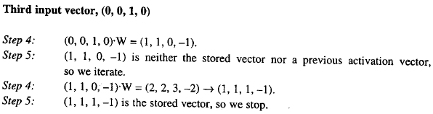
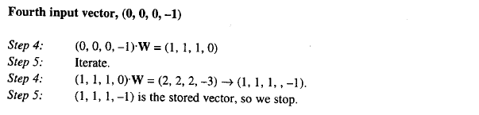
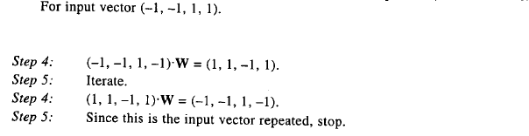


Three missing components
OK
Three missing components
OK
Three mistake components
(–1, –1, 1, 1) . W = (–1, –1, –1, 1)
(–1, –1, – 1, 1) . W = (–1, –1, –1, 1)
Not OK

Slide 2
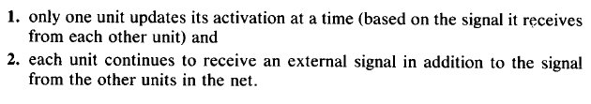
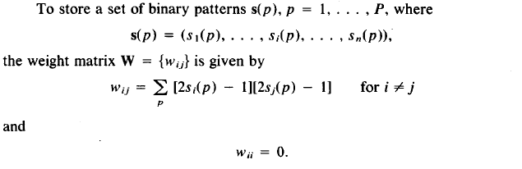
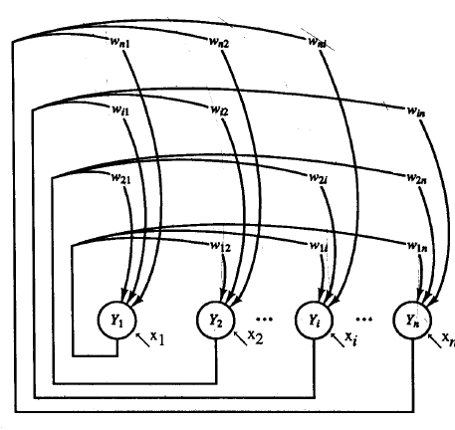
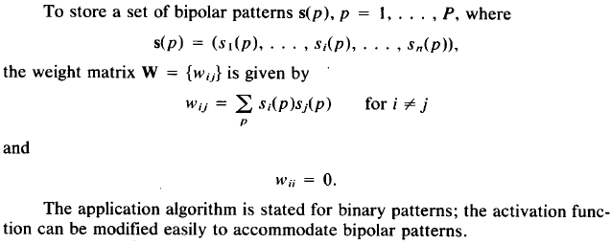
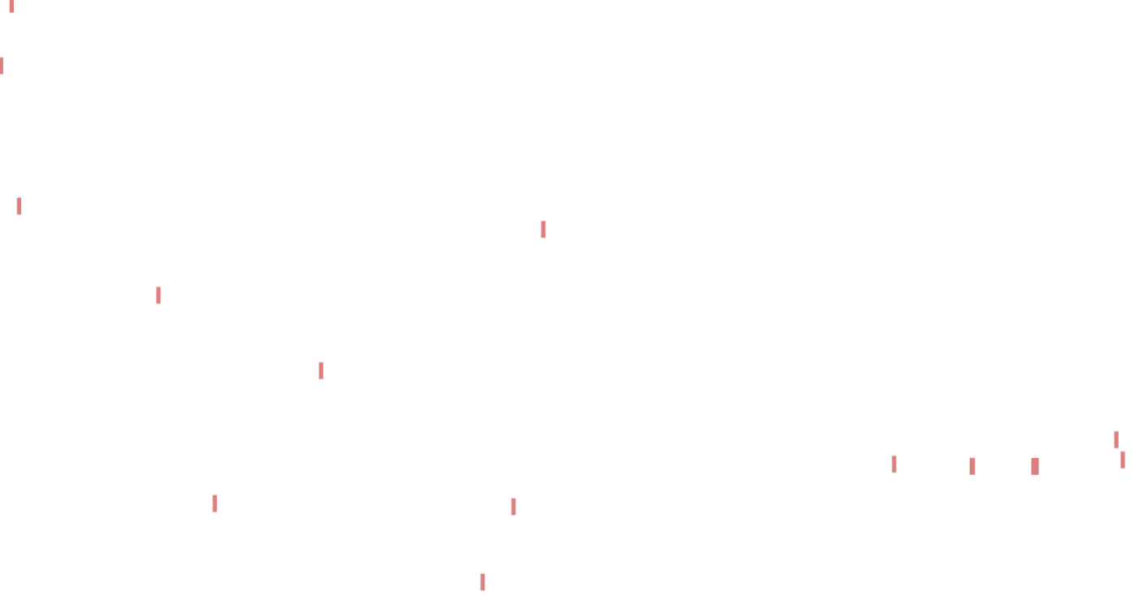
Discrete Hopfield Net (Hopfield 1982/1984)
Two Differences with the former Algorithm
Weight Matrix Initialization (Modified Hebbian Learning Method)

Slide 3
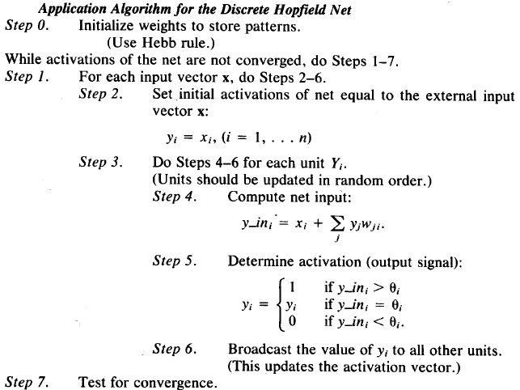
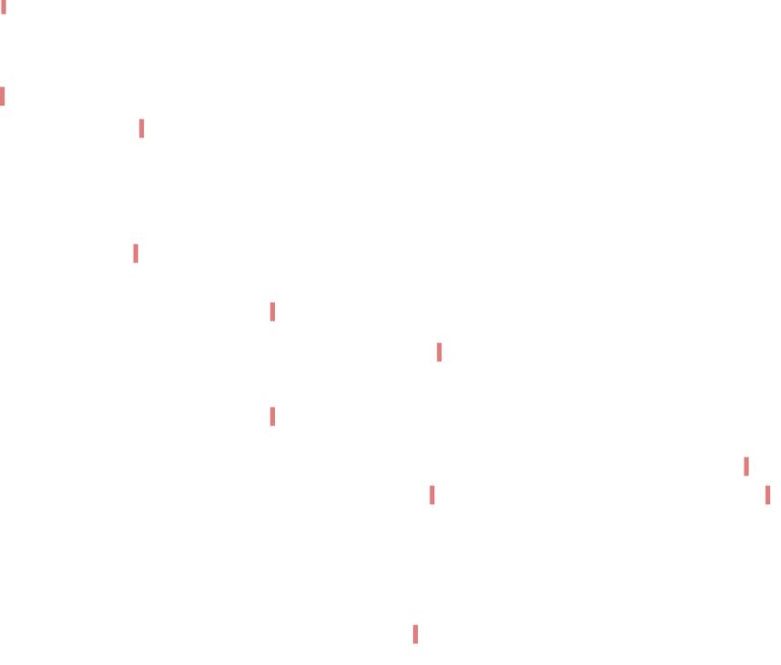

Slide 4
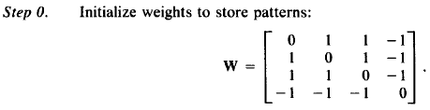
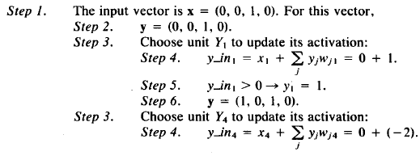

Example
Original (binary) stored pattern
Mistakes in the first and second components of the stored vector
Random Orders for computations: 1,4,3,2

Slide 5
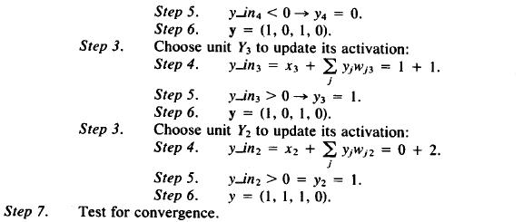
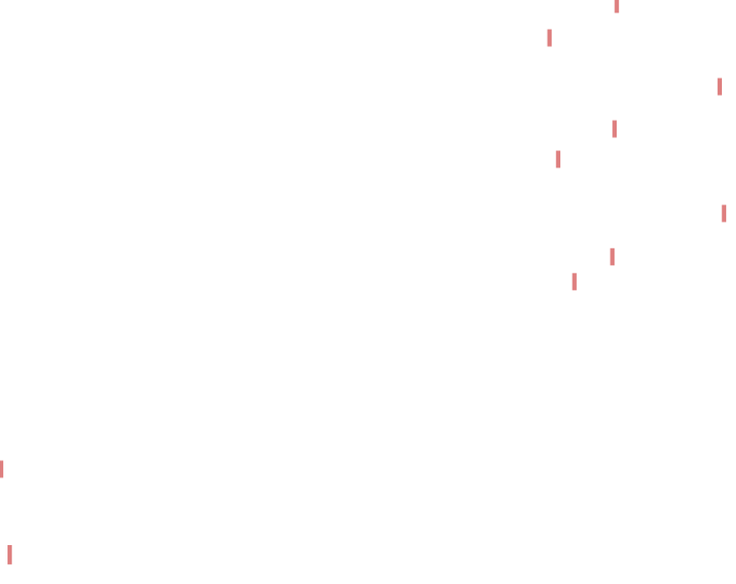
Important Notes
Hopfield has utilized the gradient of a quadratic function as recurrent rules for output units of the network.
Repeating such recurrent rules causes that the energy function converges to a local minimum point and the output pattern will converge to a certain pattern.

